Slide 1


ECEN 403
Creating STEM Contents: Solar Power with a Tracking System
Leo Predanic
George Thuita
Brandon Cenci
Sponsor: Dr. Won Jang
TA: Sambandh Dhal

Slide 2

Executive Summary
Problem statement:
In order to create the future of tomorrow, we must invest in the future today - by getting students interested in STEM early in their education
Our Solution:
Excite K-12 students by creating a portable solar powered system for demonstration purposes
Contain digestible figures & animations to describe/track system operation, functionality, and performance in different operation modes

Slide 3
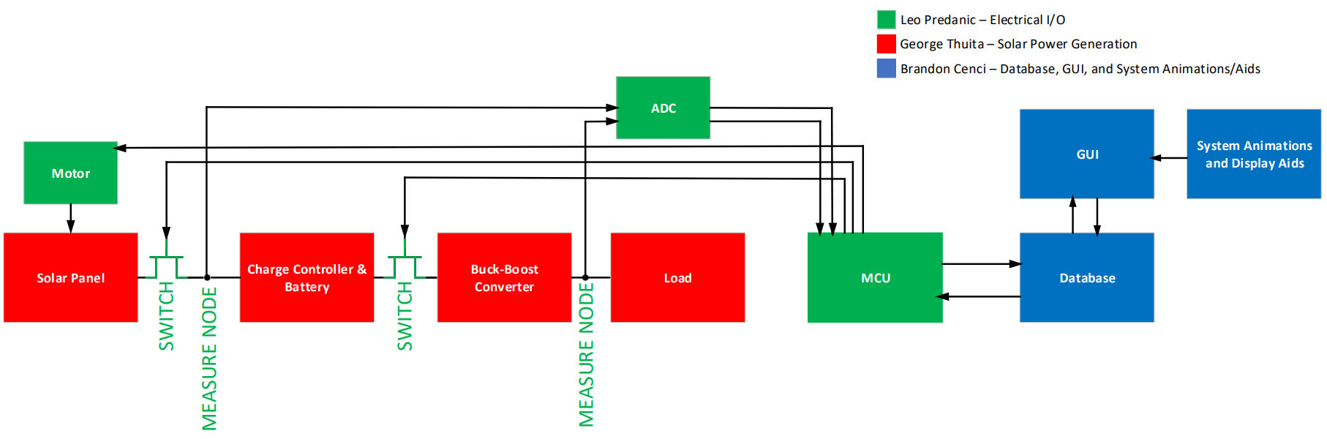
System Flow & Overview
System is partitioned into three main subsystems

Slide 4
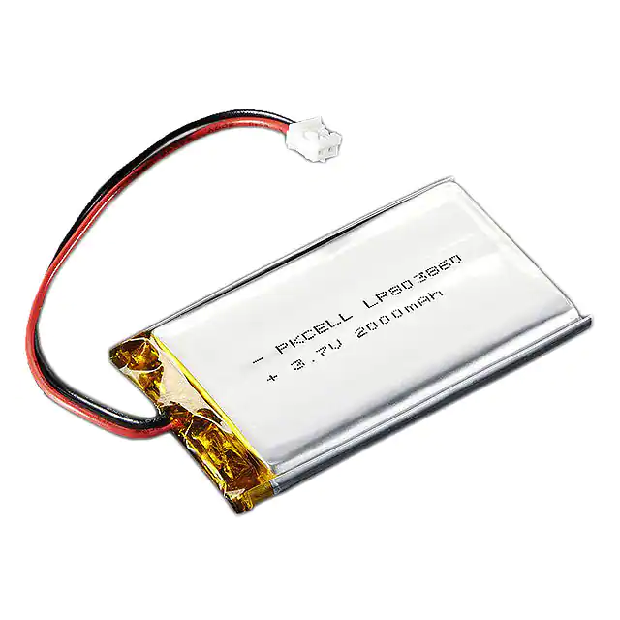
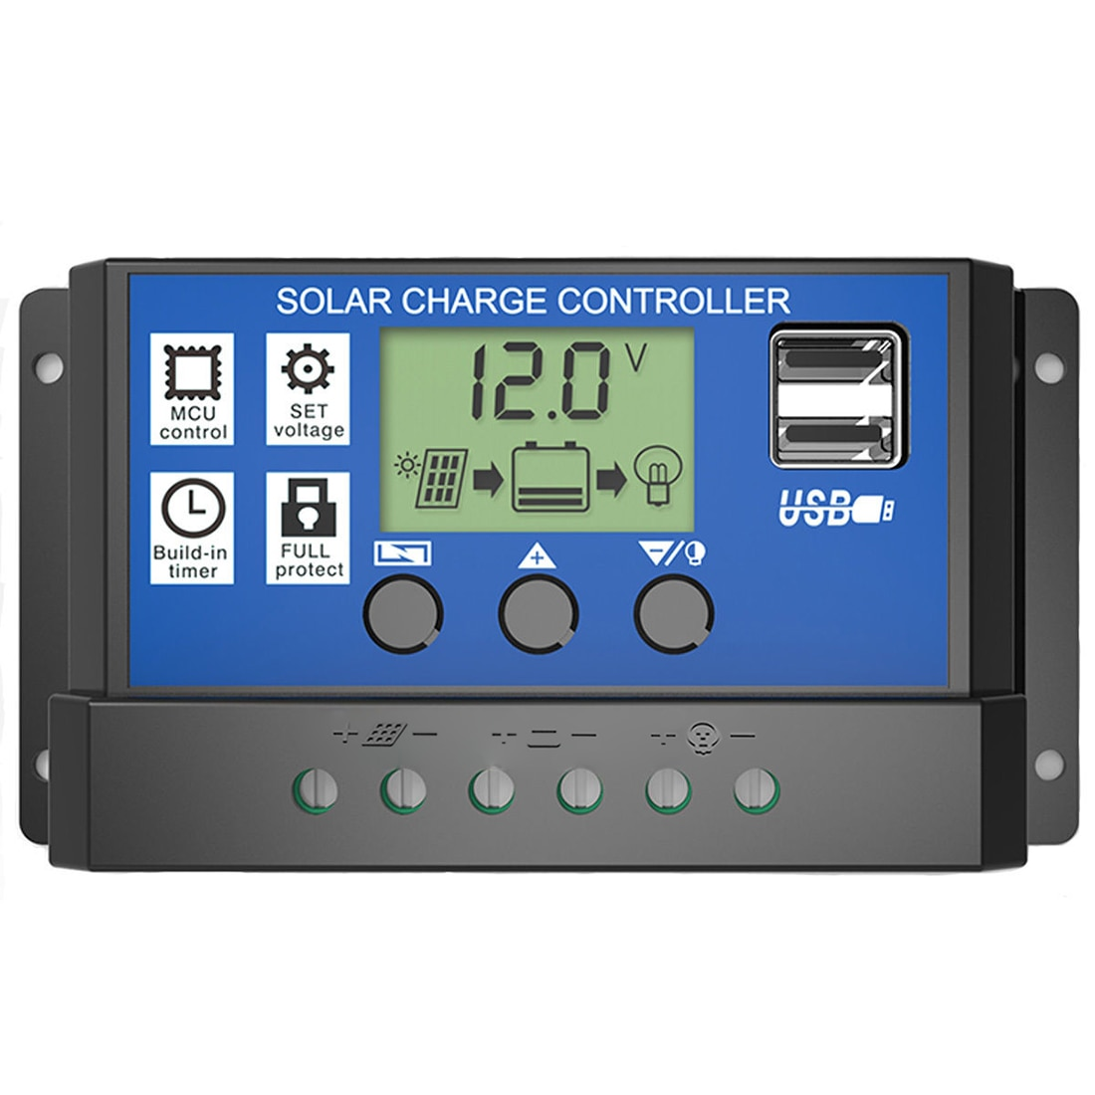
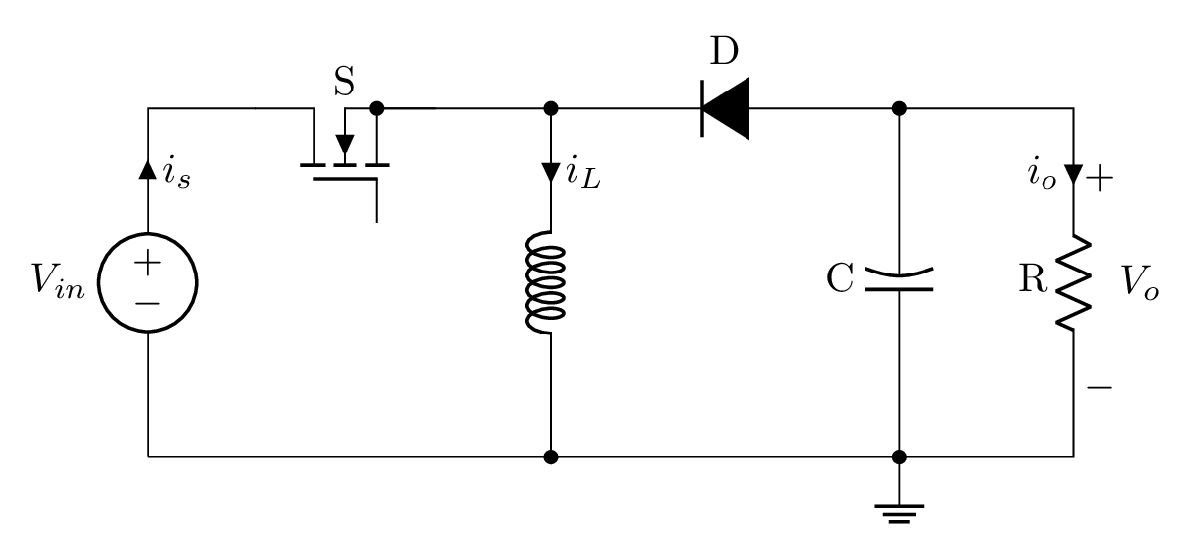
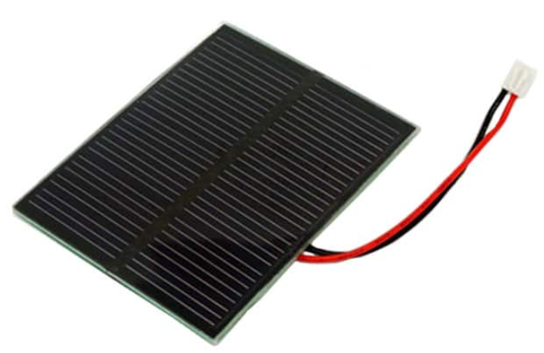

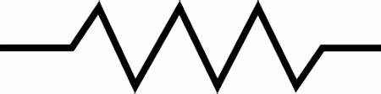
Solar Power Generation Subsystem
Focus is to generate power from a solar cell and store it in a battery.
Monitor battery level to prevent damage from overcharge
Provide appropriate power from source to loads
180° about Zenith Angle

Slide 5
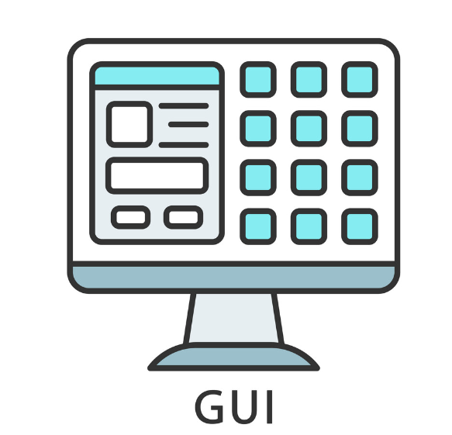

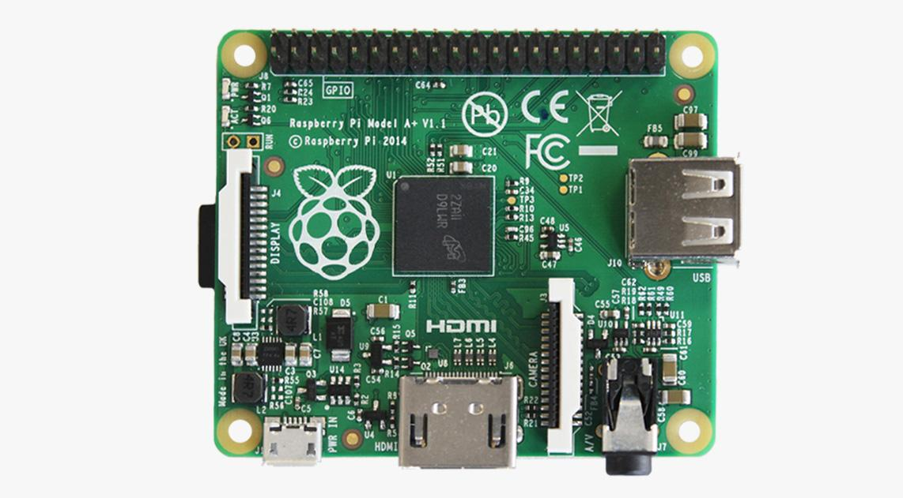
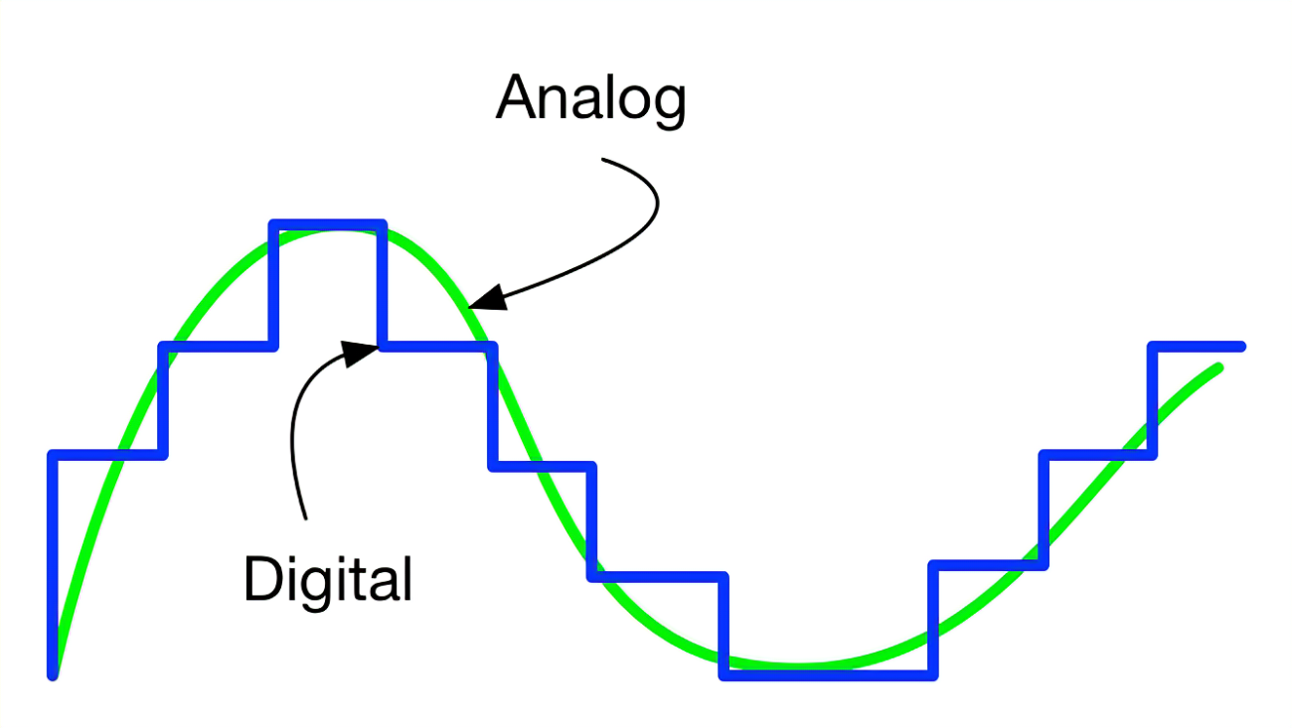

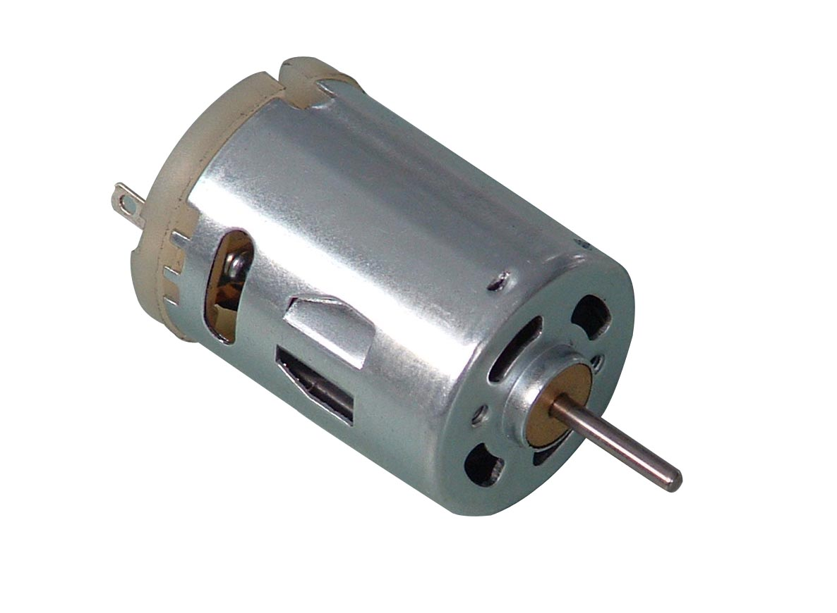
Electrical I/O Subsystem
Functionality serves to control power generation & distribution
Communicates with GUI & database to control modes and provide data
Perform analog V & I measurements to make control decisions and record power
A2D
Raspberry Pi (RPI)

Slide 6
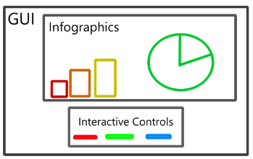
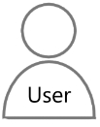
GUI & Database Subsystem
Data from microcontroller stored to onboard database
Database provides input for animations/graphs in GUI
Displays infographics about current status to viewer
GUI uses built-in buttons to give user control

Slide 7
Execution
Currently: Parts selected, majority ordered. Structure for subsystems designed. Beginning circuit and code level development.
 | 10/14/22 | 10/28/22 | 11/11/22 | 11/22/22 | 12/2/22
Solar Power Generation | 90% complete simulations of buck-boost converter and load. | Finish simulations and order passive components. | 50% PCB completion. | 100% PCB completion. | Demo.
Electrical I/O | RPI can implement ADC and perform measurements. | RPI can control switches. Data processing & write sample output. | RPI can control motor. | Subsystem Verification. | Demo.
GUI & Database | 70% Database setup. | 100% Database setup. 30% GUI. | 100% GUI. 30% Animations. | 100% Animations. | Demo.

Slide 8
Validation
 | 10/28/22 | 11/11/22 | 11/22/22 | 12/2/22
Solar Power Generation | Test battery charging. | Test power delivery to load. | Verify full subsystem power delivery. | Demo.
Electrical I/O | Testbench to measure arbitrary voltage/current. Assist in power generation testing. | Testbench for switches and measurements. Assist in power generation testing. | Verify motor control with full subsystem integration. | Demo.
GUI & Database | Test sample data write/read. | Test GUI/database communication. | Verify subsystem is user interactable. | Demo.

Slide 9
Questions?

